Slide 1









My Number
Interactive Notebook
$$×$$
$$\frac{1}{2}$$
$$÷$$
$$+$$
$$−$$
$$\frac{3}{5}$$
$$7$$
Name
Class
Teacher
Term 1 Semester 1
$$5^{2}$$
$$\sqrt{9}$$
1

Slide 2
Contents
Glossary or Formula Page
Page
Date
Description
2
3

Slide 3
Tasks
24
7
30
Essential Question
Questions
Notes
Summary
6
7

Slide 4
Factor Rap IPAD

Slide 5
24
7
30
Date
Factors
EQ – How do I find the HCF of two numbers?

Slide 6
24
7
30
Date
Factors
EQ – How do I find the HCF of two numbers?
What is a factor?

Slide 7
24
7
30
Date
Factors
EQ – How do I find the HCF of two numbers?
What is a factor?
The numbers that divide exactly into another number with no remainder.

Slide 8
24
7
30
Date
Factors
EQ – How do I find the HCF of two numbers?
What is a factor?
The numbers that divide exactly into another number with no remainder.
How do I find the factors of a number?

Slide 9
24
7
30
Date
Factors
EQ – How do I find the HCF of two numbers?
What is a factor?
The numbers that divide exactly into another number with no remainder.
How do I find the factors of a 15?
Find the numbers that multiply to give 15.

Slide 10

24
7
30
Date
Factors
EQ – How do I find the HCF of two numbers?
What is a factor?
The numbers that divide exactly into another number with no remainder.
How do I find the factors of a 15?
Find the numbers that multiply to give 15.
$$1×15$$
$$3×5$$

Slide 11
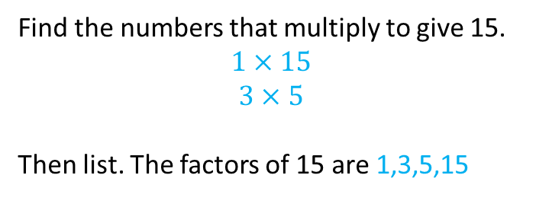
24
7
30
Date
Factors
EQ – How do I find the HCF of two numbers?
What is a factor?
The numbers that divide exactly into another number with no remainder.
How do I find the factors of a 15?
Find the numbers that multiply to give 15.
$$1×15$$
$$3×5$$
Then list. The factors of 15 are 1,3,5,15

Slide 12
24
7
30
Date
Factors
EQ – How do I find the HCF of two numbers?
What is a factor?
The numbers that divide exactly into another number with no remainder.
How do I find the factors of a 15?
Find the numbers that multiply to give 15.
$$1×15$$
$$3×5$$
Then list. The factors of 15 are 1,3,5,15
What is the HCF?

Slide 13
24
7
30
Date
Factors
EQ – How do I find the HCF of two numbers?
What is a factor?
The numbers that divide exactly into another number with no remainder.
How do I find the factors of a 15?
Find the numbers that multiply to give 15.
$$1×15$$
$$3×5$$
Then list. The factors of 15 are 1,3,5,15
What is the HCF?
Highest Common factor
How do I find the HCF of two numbers?

Slide 14
24
7
30
Date
Factors
EQ – How do I find the HCF of two numbers?
What is a factor?
The numbers that divide exactly into another number with no remainder.
How do I find the factors of a 15?
Find the numbers that multiply to give 15.
$$1×15$$
$$3×5$$
Then list. The factors of 15 are 1,3,5,15
What is the HCF?
Highest Common factor
How do I find the HCF of two numbers?
List the factors of both numbers.
Then find the highest number in both lists.

Slide 15
24
7
30
Date
Factors
EQ – How do I find the HCF of two numbers?
What is a factor?
The numbers that divide exactly into another number with no remainder.
How do I find the factors of a 15?
Find the numbers that multiply to give 15.
$$1×15$$
$$3×5$$
Then list. The factors of 15 are 1,3,5,15
What is the HCF?
Highest Common factor
How do I find the HCF of two numbers?
List the factors of both numbers.
Then find the highest number in both lists.
Example
Find the HCF of 8 and 20

Slide 16
24
7
30
Date
Factors
EQ – How do I find the HCF of two numbers?
What is a factor?
The numbers that divide exactly into another number with no remainder.
How do I find the factors of a 15?
Find the numbers that multiply to give 15.
$$1×15$$
$$3×5$$
Then list. The factors of 15 are 1,3,5,15
What is the HCF?
Highest Common factor
How do I find the HCF of two numbers?
List the factors of both numbers.
Then find the highest number in both lists.
Find the HCF of 8 and 20
Factors of 8 – 1, 2, 4, 8
Factors of 20 -1, 2, 4, 5, 10, 20
Example

Slide 17
24
7
30
Date
Factors
EQ – How do I find the HCF of two numbers?
What is a factor?
The numbers that divide exactly into another number with no remainder.
How do I find the factors of a 15?
Find the numbers that multiply to give 15.
$$1×15$$
$$3×5$$
Then list. The factors of 15 are 1,3,5,15
What is the HCF?
Highest Common factor
How do I find the HCF of two numbers?
List the factors of both numbers.
Then find the highest number in both lists.
Find the HCF of 8 and 20
Factors of 8 – 1, 2, 4, 8
Factors of 20 -1, 2, 4, 5, 10, 20
Example

Slide 18
24
7
30
Date
Factors
EQ – How do I find the HCF of two numbers?
What is a factor?
The numbers that divide exactly into another number with no remainder.
How do I find the factors of a 15?
Find the numbers that multiply to give 15.
$$1×15$$
$$3×5$$
Then list. The factors of 15 are 1,3,5,15
What is the HCF?
Highest Common factor
How do I find the HCF of two numbers?
List the factors of both numbers.
Then find the highest number in both lists.
Find the HCF of 8 and 20
Factors of 8 – 1, 2, 4, 8
Factors of 20 -1, 2, 4, 5, 10, 20
So the HCF of 8 and 20 is 4
Example

Slide 19
Notes Review
24, 7 ,30
Date
Title
Essential question
Notes complete
Notes complete with colour and diagrams
Questions completed
Contents page filed in
Formula page filled in

Slide 20
Homework
Review your notes and write a summary answering the essential question.

